Slide 1
Fall 2015 Registration and Fee Bill Payment Overview
Notes:
PW suggestion: Insert one slide to offer big-picture agenda (“Tell them what you are going to tell them before telling them.”)

Slide 2
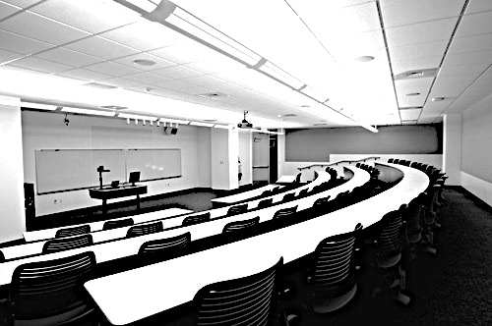
AGENDA
REGISTRATION BARS
COURSE SCHEDULES
REGISTRATION
ADD/DROPS
TUITION PAYMENT OPTIONS
TUITION PAYMENT DEADLINE
FINANCIAL ISSUES

Slide 3
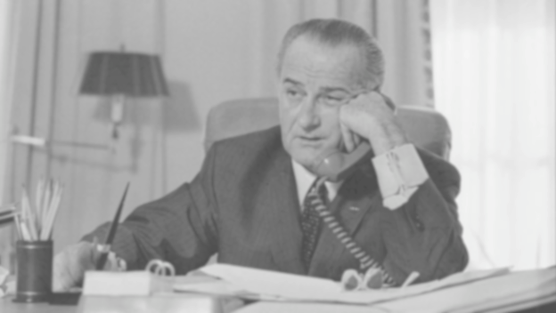
Clear Your Registration Bars
https://utdirect.utexas.edu/registrar/ris.wbx
Notes:
Advising bar notes: The LBJ School rarely imposes advising bars. Dual degree students often have advising bars imposed by the other major. In these cases, the LBJ School cannot clear your advising bar; instead, you must contact the academic unit that imposed the bar to have it cleared.
PW Stylisitic: Space before Advising Bars

Slide 4
Types of Bars
Financial: health services; library or parking fines.
Non-Financial: outstanding transcripts (GIAC), incomplete immunization records (UHS), missing emergency contact info (DOS ‘Type E’ bar).
Advising: Contact OSAP; dual-degree students are encouraged to contact partner program

Slide 5
LBJ School Course Schedule
Your PRIMARY registration resource: http://www.utexas.edu/lbj/schedule
Available earlier than Registrar’s online course schedule.
Check for updates and changes OFTEN, especially PRIOR to registering.
For LBJ School course offerings:
Course descriptions and course syllabi
Course meeting dates and times
Instructor bio and contact information
Notes:
PW suggestion: First two bullet points are actually one single point.

Slide 6
Registrar’s Course Schedule
Your secondary registration resource.
Available online at: http://registrar.utexas.edu/schedules/.
Published roughly two weeks prior to registration.
For university-wide course offerings:
Course availability after registration begins (tells you whether a course is open, closed/full, restricted, or waitlisted).
All Non-LBJ School courses.
Notes:
Course Availability: (provides the enrollment status for any UT Austin course: open, closed and/or waitlisted. This information will help you to create a realistic plan for registration).
Realistic plan= if a preferred class is closed or full, you’ll know that you need to select an alternate course. Don’t assume all the classes you want to register for will be open to you at the time you register.

Slide 7
Fall 2015 Registration
Registration for Fall 2015 LBJ School courses begins at 8:00 AM on Friday, August 21.
Check your Registration Information Sheet (RIS) for your specific add/drop access periods thereafter.
To assist you with registration, OSAP will be open from 8:00 AM - 5:00 PM on Friday, August 21 (PhD, MPAff & MGPS Graduate Advisors will also be available).
Notes:
I. You are more likely to get into your preferred courses with your preferred instructors if you do not delay registration.

Slide 8
MPAff Fall 2015 PRP Course Registration Procedure
Notes:
PW suggestion: (1) Mention that MGPS students don’t take PRP until the second year. (2) Keep in mind that PRP Fair will be past tense at this session. (3) There will be a few MPAffers who did not attend the PRP Fair and therefore do not know about Qualtrics. Tell them to gather around the podium at the end of the session so pat can explain the process.
Go to UT Registration website in open browser!

Slide 9
Done!
You have already attended the MPAff PRP Fair on Tuesday and heard about the various PRP’s that are offered this academic year.
To Do:
Submit the MPAff PRP Preference Form via the link on CANVAS (LBJ Summer Transition 2015 – PRP) no later than 5:30 PM on Thursday, August 20. Complete the form even if you do not plan to take the PRP this semester or don’t have a preference on the PRP to which you will be assigned.
Check CANVAS (LBJ Summer Transition 2015 – PRP) for PRP assignments after 9:00 PM on Thursday, August 20.
Register for your assigned PRP on Friday, August 21 (and again during spring 2016 registration).

Slide 10
Registration Screen Shot

Slide 11
Registration Screen Shot

Slide 12
Special Registration Needs?
Contact us in advance of registration (when possible) for assistance. Be sure to include your UT EID.
Graduate Advisor/Faculty approval is required when registering for a non-LBJ course or an independent study course (i.e., conference course, internship course, Professional Report, etc.)
Don’t forget to include your UT EID and complete course information (course number, unique number and title) in all correspondence.
Notes:
If you wait until registration commences (or ends) to ask for help it may be too late for a GPC to assist you.
Show website for Registration Forms & Procedures
PW: I would delete the two examples from this slide. Also, are you sure you want to say that about part timers out loud? Also: Should we add a bullet about special course arrangements that require your/my action (conference course, non-LBJ course)?

Slide 13
Add/Drop Periods
The University schedules one or more add/drop periods after each primary registration period.
Grad students may add and/or drop classes online through the 4th class day of the spring or fall semesters (or 2nd class day of summer).
To add or drop a class after the 4th class day of fall or spring (or 2nd class day of summer), grad students must contact the department offering the course to be added or dropped.
NO refunds for classes dropped after the 12th class day of any spring or fall semester.
DELETE drop available through 11 September.
Q-drop available 12 September through 23 September.
Visit the University’s Academic Calendar online to learn about details: http://registrar.utexas.edu/calendars/.
Notes:
PW: Might want to delete “Fine-Tuning” from the title, now that you have deleted the previous slide. Also: Should we add a bullet for Q-drop?

Slide 14
Payment and Confirming Attendance
5:00 PM on Monday, August 31 is the DEADLINE to pay your FALL 2015 tuition and fee bill and/or confirm your attendance to fall semester classes.
View your tuition and fee bill, make payment and/or confirm your attendance online at: https://utdirect.utexas.edu/acct/fb/my_tuition/my_tuition_home.WBX.
Students who fail to meet the payment/confirmation deadline WILL be dropped from classes.
If you are dropped from your classes for non-payment or failure to confirm your attendance, there is no guarantee you’ll get back into the classes for which you’ve previously registered.

Slide 15
Zero $0.00 Tuition Bill and Third Party Payments
Even if you have a zero ($0.00) tuition bill due to a third party billing arrangement, you still need to confirm your attendance to classes online before the payment deadline date each semester at: https://utdirect.utexas.edu/acct/fb/my_tuition/my_tuition_home.WBX.
Failure to confirm your attendance to classes by the payment deadline will result in cancellation of your registration.
Key phrase to look for when completing the process:
**Your registration is complete and your courses are secured**

Slide 16
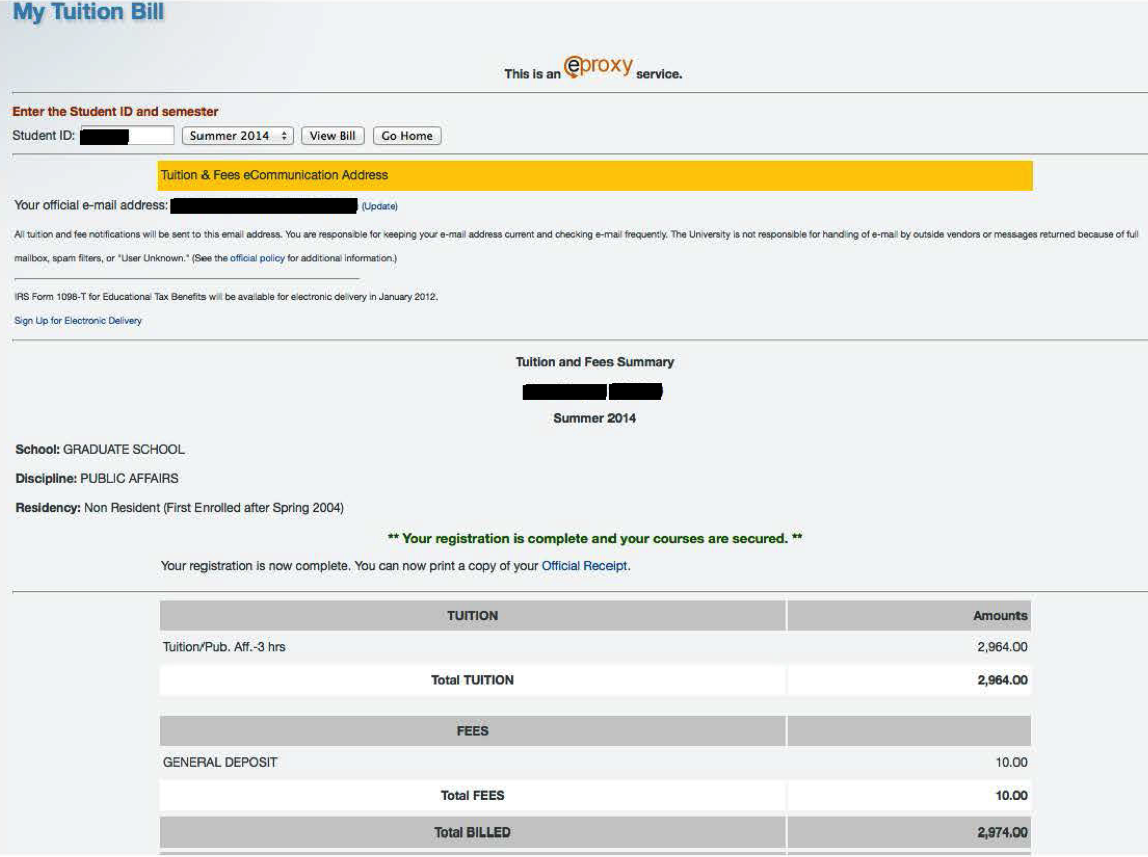
Attendance Confirmed: “Your Registration is Complete”
Notes:
PW suggestion: If this is the last slide before the break, you might want to insert a slide after this one to that effect.

Slide 17
Students with LBJ School Fellowships
LBJ and Graduate School Fellows must pay their Fall 2015 tuition bills before fellowship award payments will disburse.
Fellowship funds will be disbursed as early as August 24, 2015 provided that your tuition bill is paid.
Fellowship funds take two to three business days from the payment date to be deposited into your bank account.
Establish Direct Deposit ASAP to expedite payment.
Students can establish Direct Deposit online at: https://utdirect.utexas.edu/acct/rec/weft/webEFT_info.WBX.
Notes:
This is an accounting safeguard put in place by the University of Texas to ensure that all students who receive funds directly are actually “enrolled” in classes.
If you have been awarded a Non-Resident Tuition Entitlement waiver, it will appear as a credit to your tuition bill. If you’re unable to see this credit, please contact OSAP staff.

Slide 18
TUITION PAYMENT OPTIONS
Pay your tuition bill by check or credit card (MasterCard or Discover only) in person in Main Bldg (base of the UT Tower) Rm. 8, or online: https://utdirect.utexas.edu/acct/fb/my_tuition/tf_home.WBX?location=P.
Obtain a short-term tuition loan to pay for your tuition bill by applying online: https://utdirect.utexas.edu/acct/loans/tuit/tuit_home.WBX.
Pay your tuition bill by installment (check or credit card) by signing up for the installment plan online:http://www.utexas.edu/business/accounting/sar/pay.html - installment.
Notes:
Fellowship recipients may use any payment method to initiate the release of the LBJ School fellowship payment after Sept. 1.

Slide 19
Short Term Tuition Loans
Applying for a short-term tuition loan is a simple online process and you will be automatically approved (no credit check involved).
Short term tuition loans can only be used to pay your tuition bill.
LBJ School fellowship recipients:
Paying your Fall 2015 bill (or just 50% of your bill) by the 31 August deadline will release your fellowship.
Because you will only be taking out this loan for a few days, the interest can be as little as $5.

Slide 20
Installment Payment Plan
Only 50% of your Fall 2015 Tuition Bill
Is Due on 31 August
Remaining installment due dates and amounts are displayed on your Tuition and Fees Summary and Official Receipt pages as well as on UT’s Student Accounts Receivable website at: http://www.utexas.edu/business/accounting/sar/pay.html#installment.
Bills are sent to the student's local address prior to each installment due date.
Includes a small processing fee of $15 to pay your bill in installments.

Slide 21
Payment Questions?
Refer to the “Fall 2015 Payment Information” PDF (Student Accounts Receivable).
Visit the Office of Student Accounts Receivable web pages at: http://www.utexas.edu/business/accounting/sar/ and http://www.utexas.edu/business/accounting/sar/tuition_fees.html.
Contact the Special Billing Division of Student Accounts Receivable for individual assistance.
Office location: Main Bldg. (base of the UT Tower) Rm 4
Hours: Monday-Friday, 8:30 AM - 4:30 PM
Phone: (512) 475-7777

Slide 22
Graduate Advising Team
Chaz Nailor, Graduate Program Coordinator
c.nailor@austin.utexas.edu
Pat Wong, Graduate Advisor for Public Affairs
patwong@austin.utexas.edu
Kate Weaver, Graduate Advisor for Global Policy Studies
ceweaver@austin.utexas.edu
Victoria Rodriguez, Graduate Advisor for Ph.D. in Public Policy
victoria@austin.utexas.edu

Slide 23
LBJ Academic and Student Services
Chaz Nailor, Graduate Program Coordinator
registration, degree progress and requirements
c.nailor@austin.utexas.edu
Stacy Neumann, Graduate Program Coordinator
fellowship award packages, change of major
stacy.neumann@austin.utexas.edu
Alissa Strother, Office of the Dean
fellowship payments/disbursements, international travel & exchange
astrother@austin.utexas.edu
Cathy White, Director of OSAP
endowed internship fellowships
cswhite@austin.utexas.edu

